Slide 1

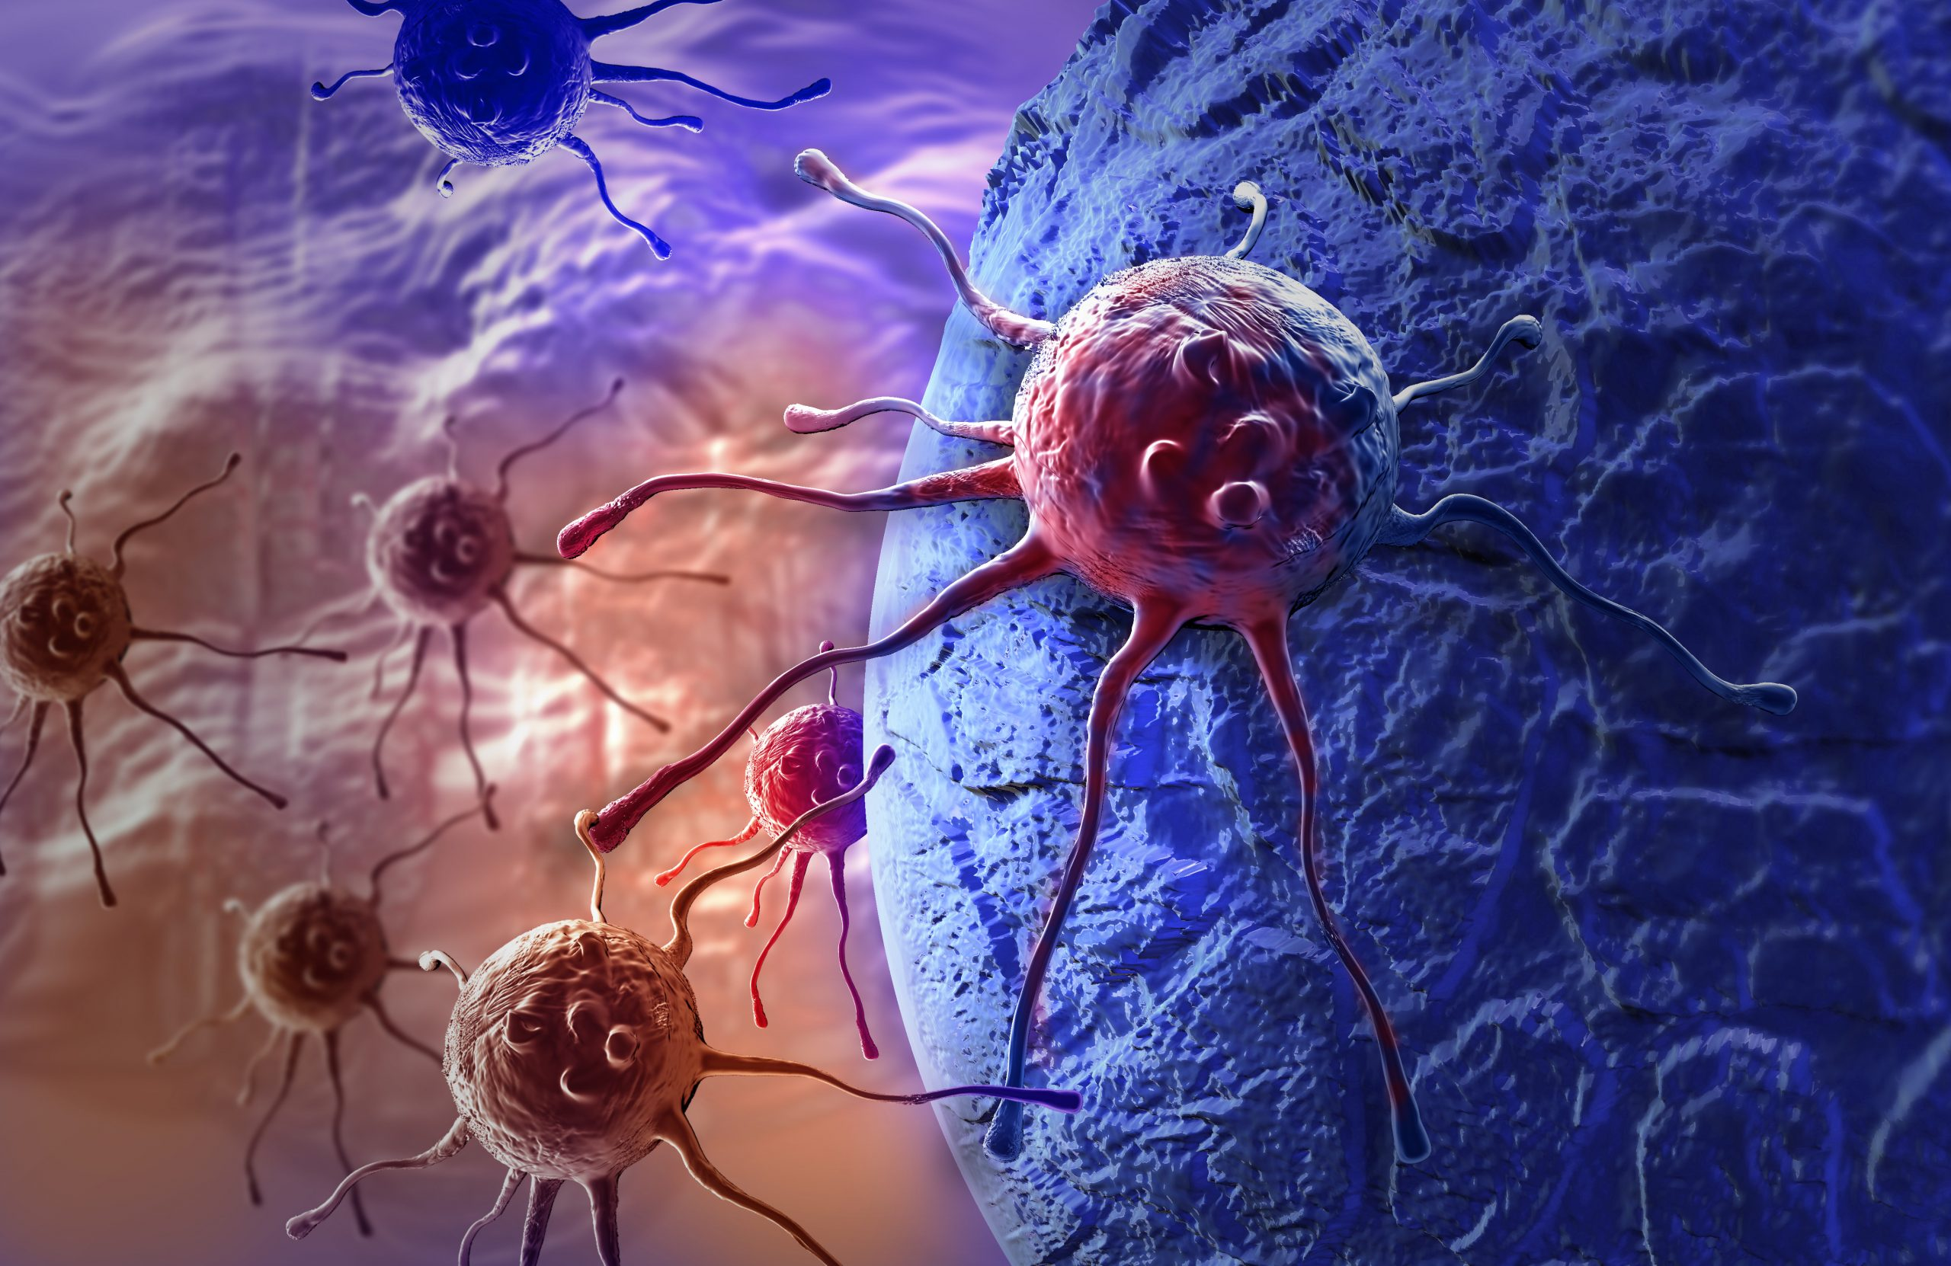
-----------------
ASSESSMENT OF ORO-PHARYNGEAL CANCERS BY UTILIZING DISTRIBUTARY VALUES LIKE AGE, GENDER, AND LOCATION OF THE AFFECTED PATIENTS
JANAKI RAMYA NAMBURU

Slide 2

--------------
Introduction
Aims and objectives
Datasets
Data Story
Summary
Conclusion
References

Slide 3

INTRODUCTION

Slide 4
Global Impact Of Cancer
Cancer is the Leading Global Cause of Mortality - WHO, 2022
Cancer is the second-leading cause of death among Americans. - Xu et al., 2022
Oropharyngeal cancer accounts for approximately 2% of all malignancies.
- Sethi et al.,2023
Annual Deaths:
Oral Cancer: 145,000
Oropharyngeal Carcinoma: 96,000 - Ferlay et al.,2018

Slide 5

Visualizing Retrospective Studies
A Pivotal tool in assessing the risk and societal impact of cancer.
Accuracy of cancer data essential for effective prevention and control.
Pinpointing risk factors is crucial in lowering incidence rates and enhancing treatment outcomes.
Prioritizing the identification of underlying causes
is paramount in averting cancer occurrence.

Slide 6

Raising Awareness for Oropharyngeal Cancer
Neglecting oral health is a concerning trend.
Early detection is crucial for complete recovery from oropharyngeal cancers.
Educating patients about the prevalence and causes of oral health issues can encourage regular screenings.
Encourage patients to take proactive control of their oral health.

Slide 7

AIMS

Slide 8
I aim to shed light on potential causative factors of oropharyngeal cancer by analyzing trends and considering various variables such as age, gender, race, state, and county.
This awareness can catalyze enhancing cancer screening, prevention, and treatment services, ultimately contributing to alleviating the burden this disease imposes on society.

Slide 9

Objectives

Slide 10
How has the prevalence of oropharyngeal cancer evolved over the past decade, and are there discernible trends or patterns in its occurrence?
Is there a significant difference in oropharyngeal cancer incidence among different age groups, and are specific age brackets more susceptible to the disease?
Are there distinct patterns in oropharyngeal cancer incidence based on racial demographics, and do certain racial groups exhibit higher or lower susceptibility?
Does the geographical location play a role in the prevalence of oropharyngeal cancer, and are there specific states where the incidence is notably higher or lower?

Slide 11
Are there significant variations in the crude rate and age-adjusted rate of oropharyngeal cancer based on geographical location, and does this information provide additional insights into regional disparities?
How do age-adjusted rates of oropharyngeal cancer compare to crude rates, and do they reveal different insights into the disease's prevalence?
Does the incidence and mortality of oropharyngeal cancer differ significantly between genders, and are there any observable trends or disparities?

Slide 12

DATASETS

Slide 13
Temporal Span: 2011 - 2020
Data Source: Centers for Disease Control and Prevention
Focus: Oropharyngeal Cancers
Participants: Robust dataset covering 52 states, representing 99% of the U.S. population
Format: Comma-Separated Excel Files
Variables:
Age
Gender
Event Type
Race
Year
Geographical Location
Population
Age-Adjusted Rate
Crude Rate
Centers for Disease Control and Prevention. (2023, June 13). United States
Cancer Statistics. Centers for Disease Control and Prevention.

Slide 14
TABLEAU STORY

Slide 15
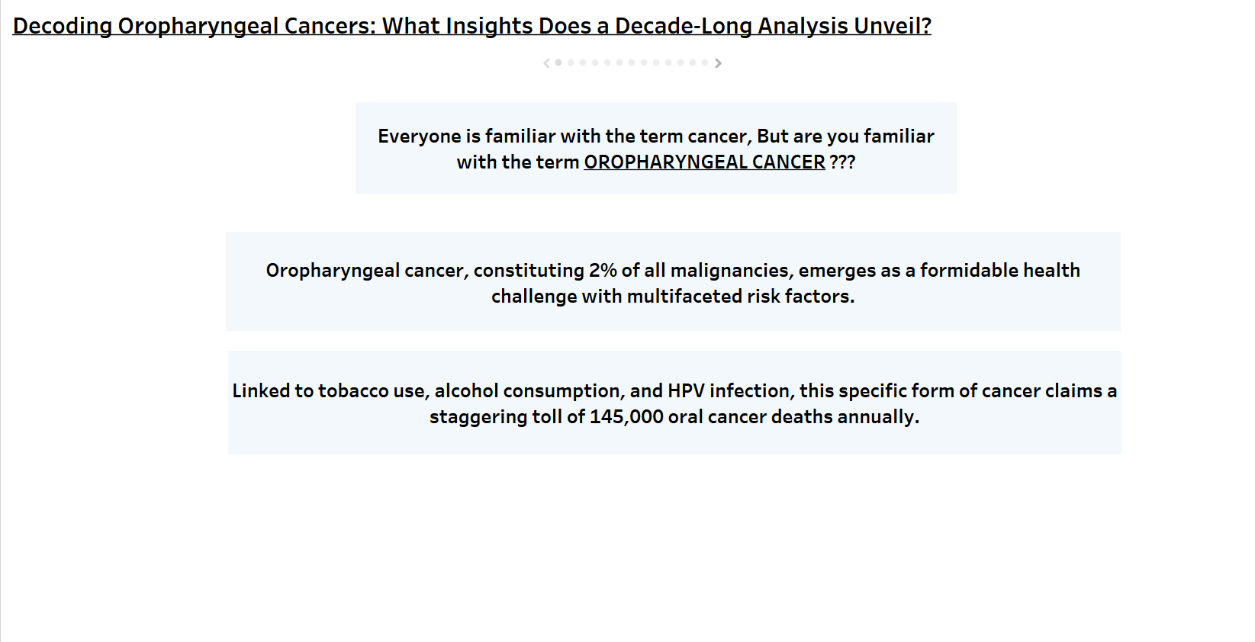

Slide 16
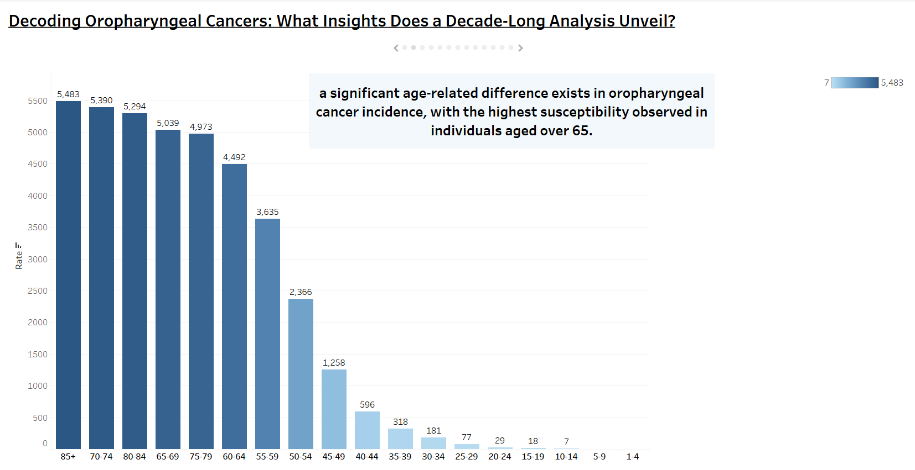

Slide 17
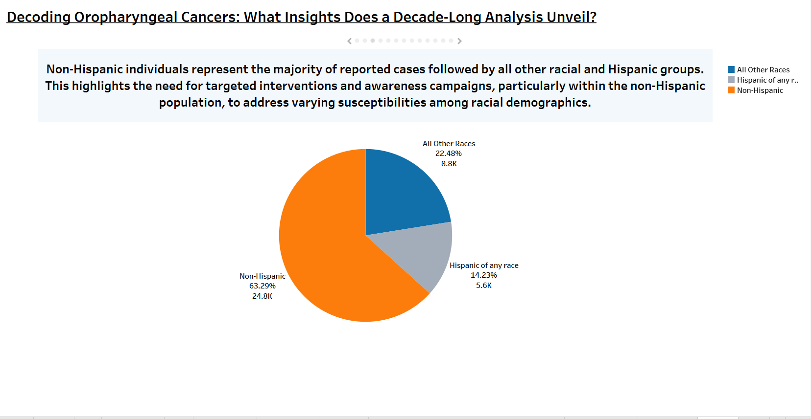

Slide 18
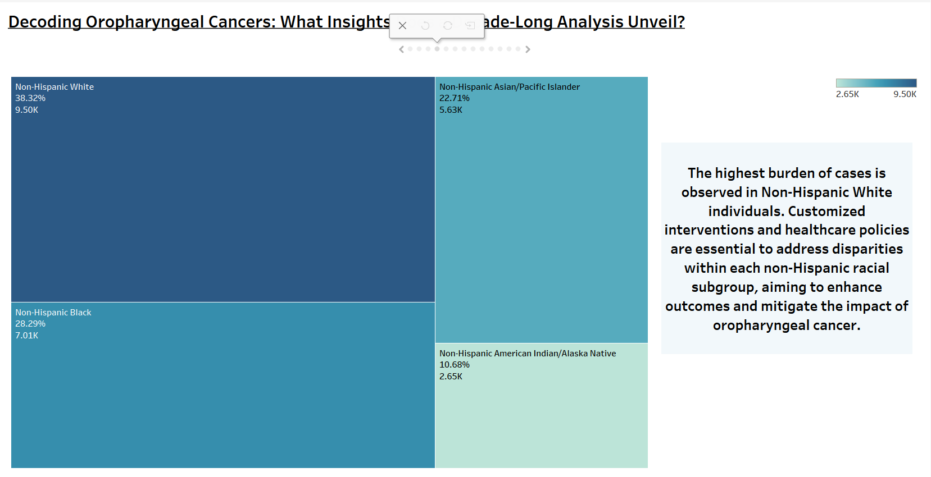

Slide 19
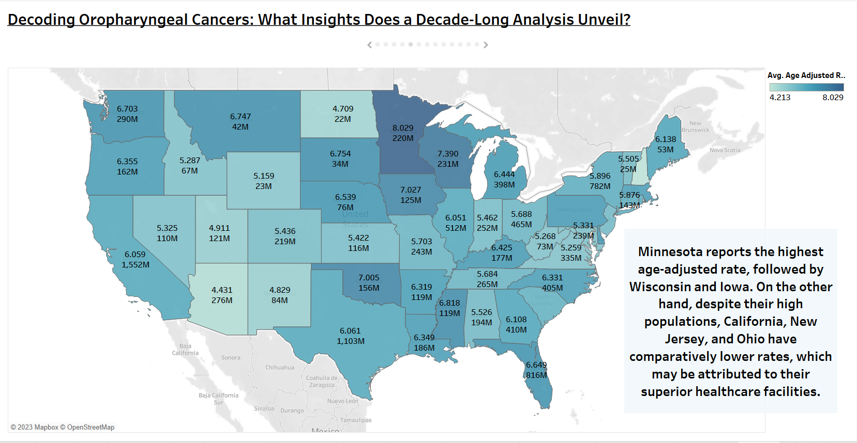

Slide 20
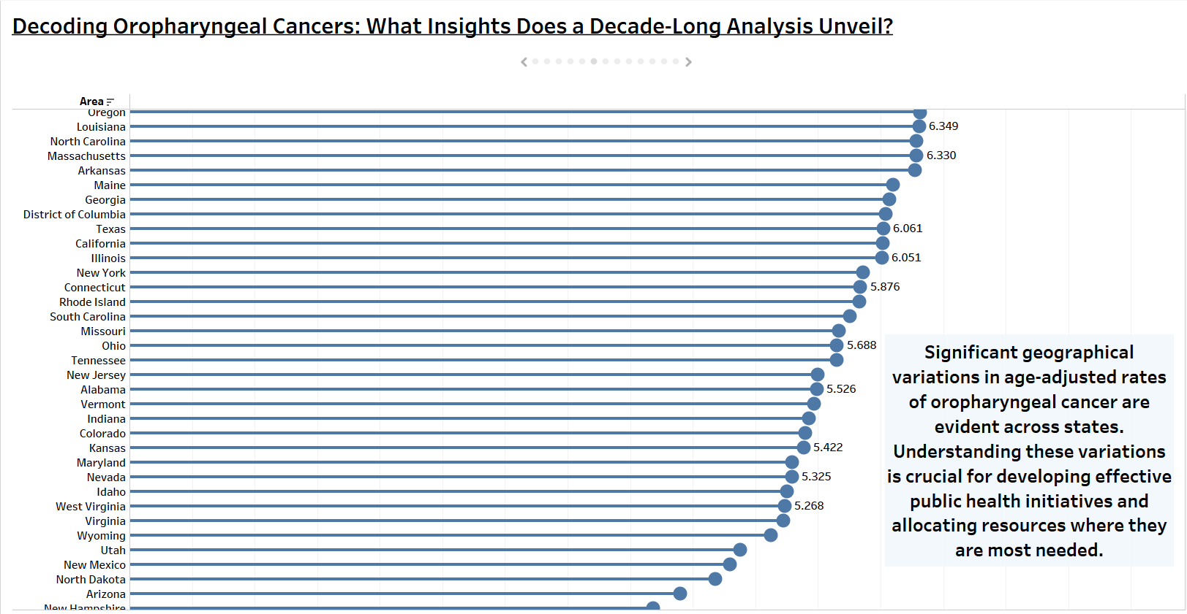

Slide 21
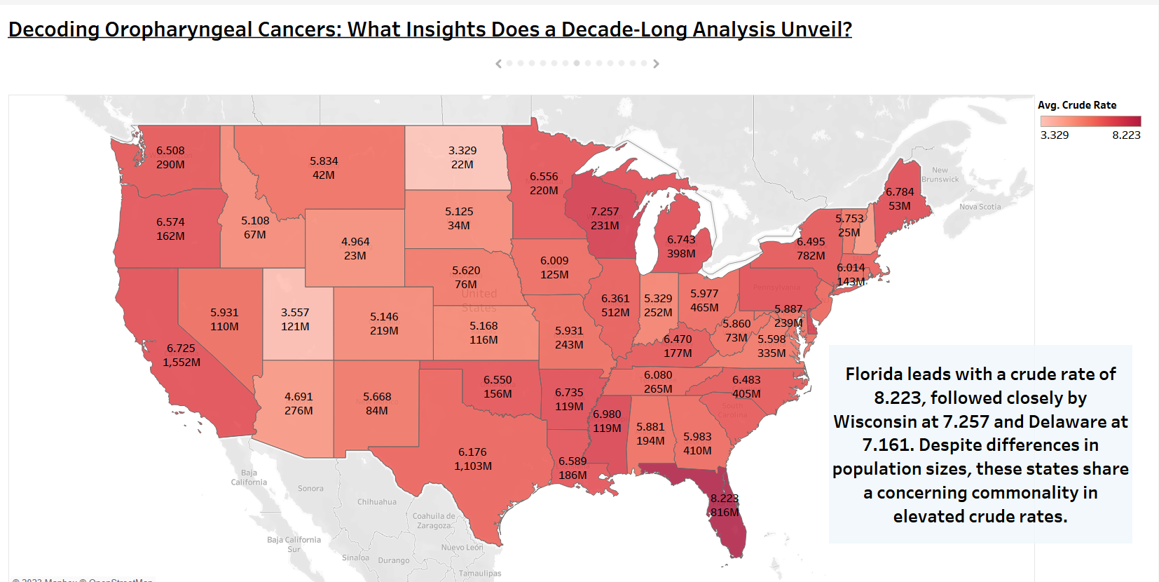

Slide 22
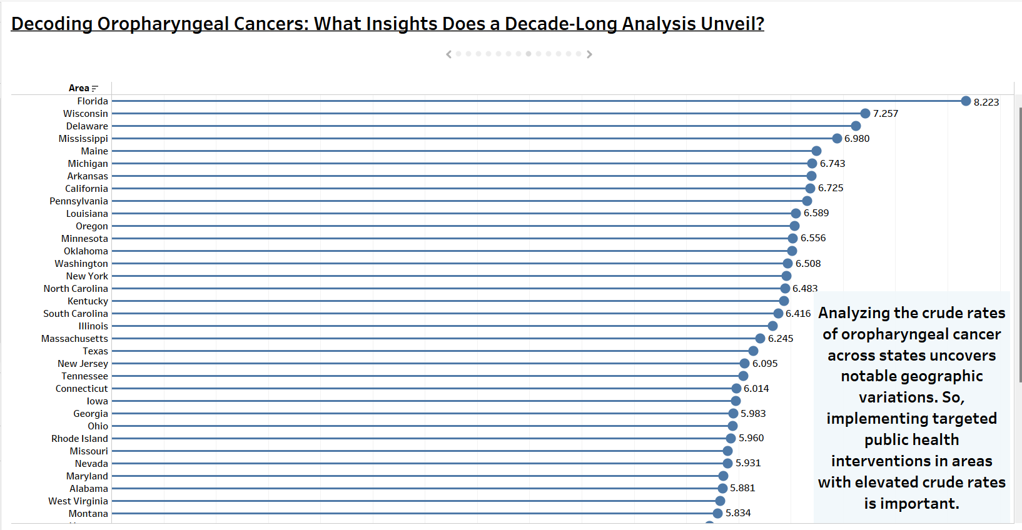

Slide 23
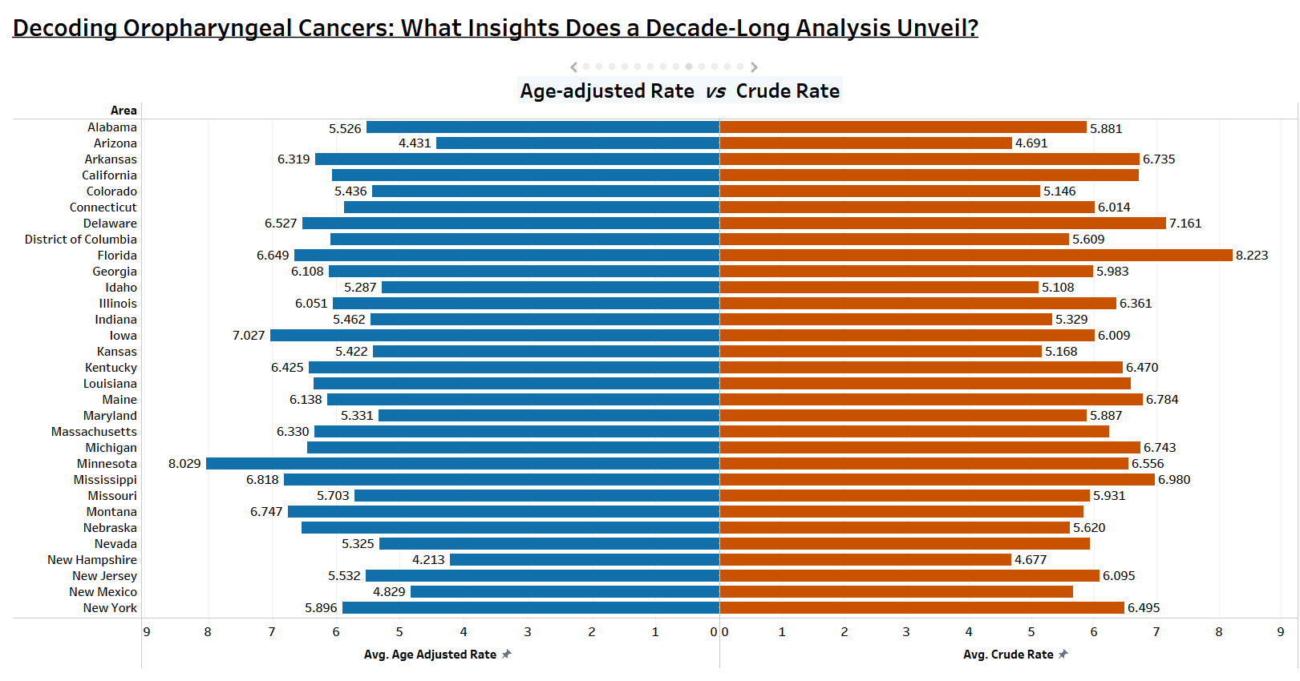

Slide 24
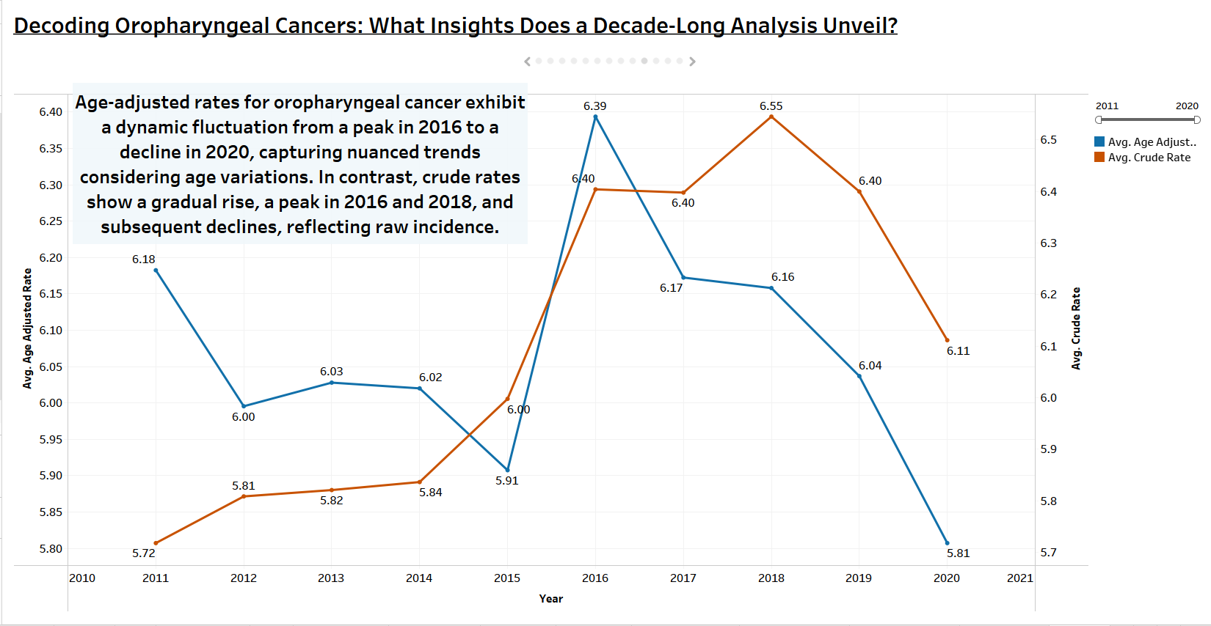

Slide 25
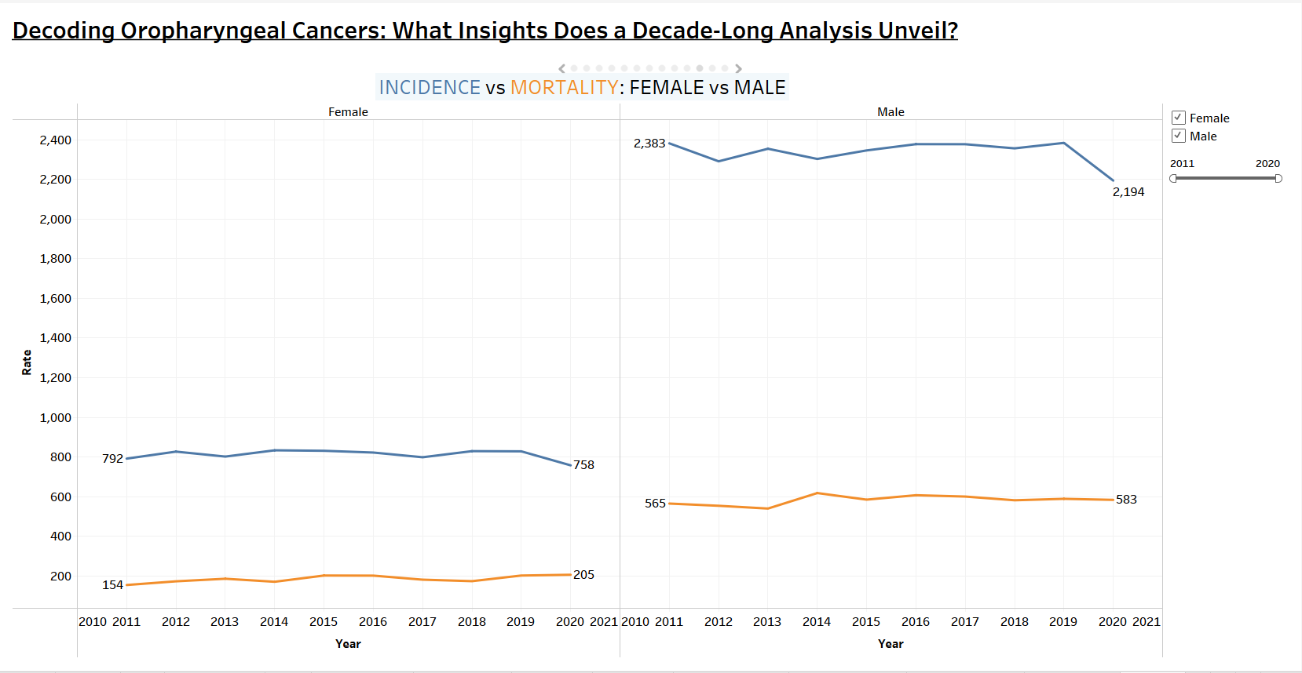

Slide 26
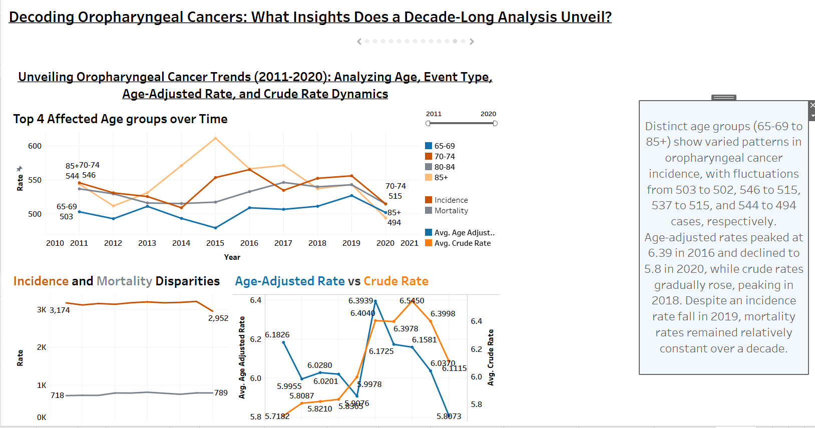

Slide 27
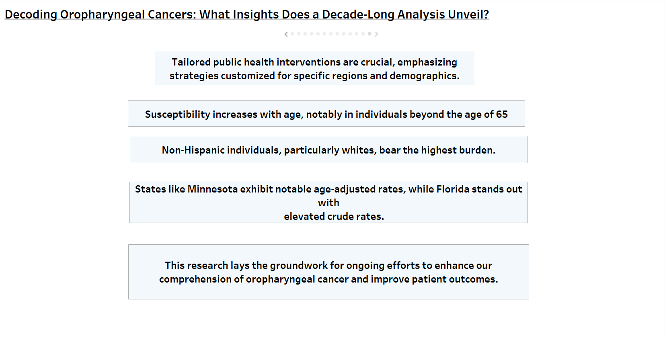

Slide 28
Dashboard

Slide 29
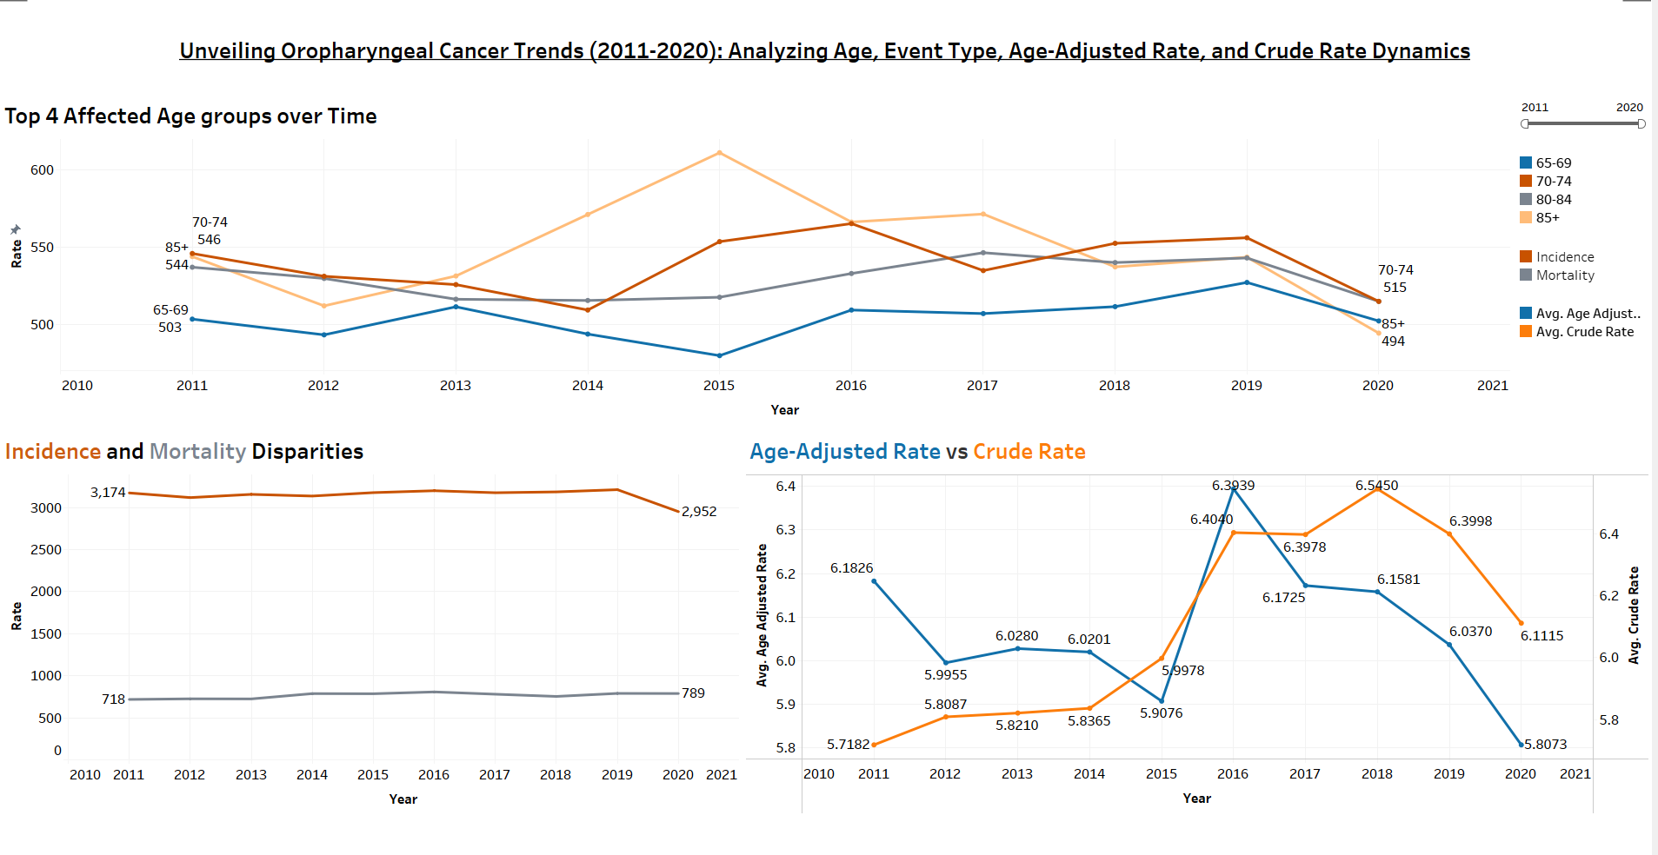

Slide 30
The top four affected age groups (65-69 to 85+) exhibit distinct patterns in oropharyngeal cancer incidence, showing fluctuations from 503 to 502 rate %, 546 to 515 rate %, 537 to 515 rate %, and 544 to 494 rate %, respectively.
Analyzing age-adjusted rates reveals a dynamic trend, peaking at 6.39 in 2016 and declining to 5.8 in 2020. In contrast, crude rates gradually rose from 2011 to 2014, peaked in 2018, and declined in 2019 and 2020, indicating variations in raw incidence.
These findings emphasize the importance of age-adjusted rates for a comprehensive grasp of oropharyngeal cancer trends, providing a more accurate reflection of prevalence and enhancing our understanding of the disease's dynamics.
The incidence rate had a significant fall in the year 2019 whereas the mortality rate is almost constant for a decade.

Slide 31


DATA STORY

Slide 32
Visualizations
Types of visualizations included:
Bar graph
Pie chart
Tree map
Map graph
Lollipop graph
Butterfly graph
Line graph

Slide 33
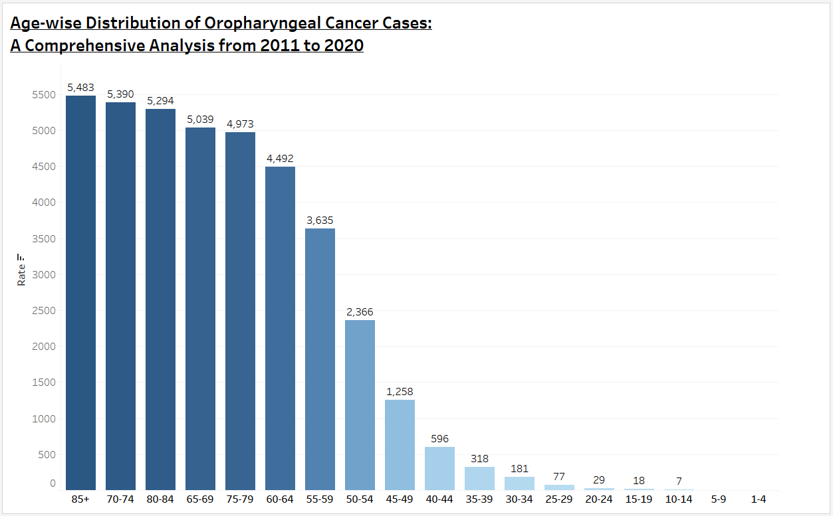
Age-wise Distribution of Oropharyngeal Cancer Cases:
A Comprehensive Analysis from 2011 to 2020

Slide 34
In this Bar graph, the variables are Age and Rate. I used these variables from my first dataset- By Age.
Age - discrete variable – it is a characteristic variable (string) – its units are in years
Rate – continuous variable – it is a numeric variable – it is measured in numbers.

Slide 35
Is There A Significant Difference In Oropharyngeal Cancer Incidence Among Different Age Groups, And Are Specific Age Brackets More Susceptible To The Disease?
Yes, a significant age-related difference exists in oropharyngeal cancer incidence, with the highest susceptibility observed in individuals aged over 65.
The most affected group is those over 85, followed by age brackets 70-74, 80-84, 75-79, and 60-64.
These findings emphasize the need for targeted screening and awareness campaigns for the elderly population, especially those beyond 85 years, to improve early detection and enhance outcomes in oropharyngeal cancer management.

Slide 36
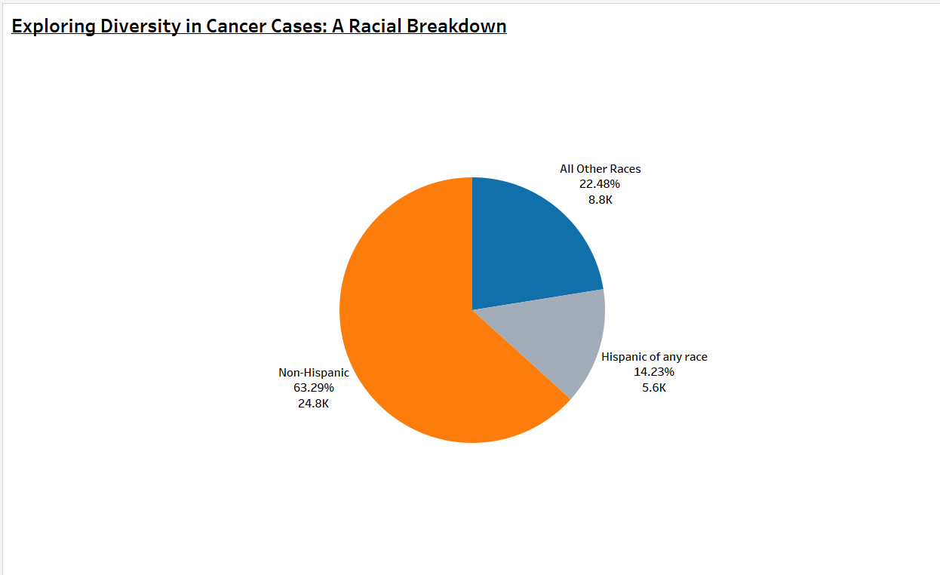
Exploring Diversity in Cancer Cases: A Racial Breakdown

Slide 37
In this Pie chart, the variables are Race and Rate. I used these variables from my first dataset- By Age.
Race- discrete variable – it is a characteristic variable – string
Race – subgroups-
Hispanic of any race
Non-Hispanic race
All other races
Rate – continuous variable – it is a numeric variable – it is measured in numbers.

Slide 38
Are there distinct patterns in oropharyngeal cancer incidence based on racial demographics, and do certain racial groups exhibit higher or lower susceptibility?
Yes, there are discernible patterns in oropharyngeal cancer incidence based on racial demographics.
Non-Hispanic individuals represent the majority of cases at 63.29%, with 24.8k reported cases. Other racial groups contribute to 23.48% (8.8k cases), while the Hispanic group exhibits the lowest incidence at 14.23% with 5.6k cases.
This highlights the need for targeted interventions and awareness campaigns, particularly within the Non-Hispanic population, to address varying susceptibilities among racial demographics.

Slide 39
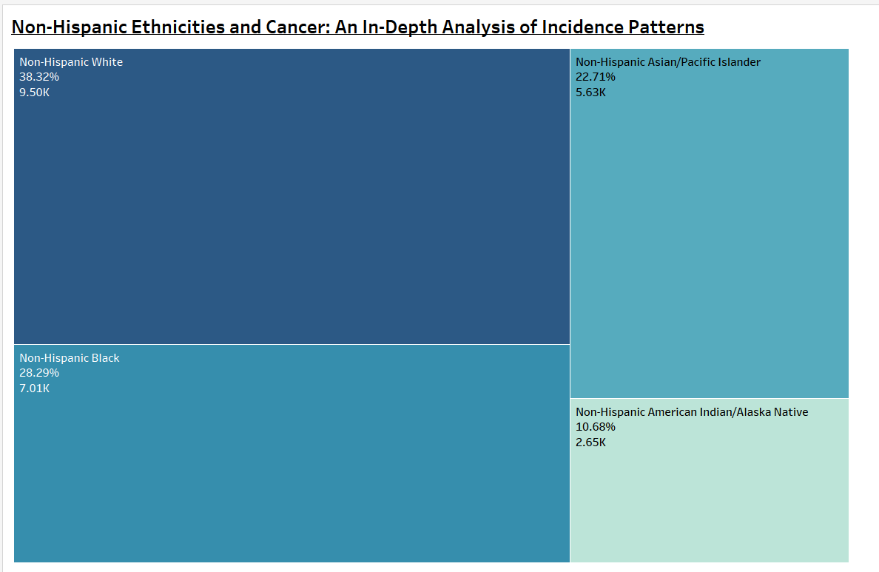
Non-Hispanic Ethnicities and Cancer: An In-Depth Analysis of Incidence Patterns

Slide 40
In this Treemap, the variables are Non-Hispanic Race and Rate. I used these variables from my first dataset- By Age.
Race- discrete variable – it is a characteristic variable – string
Non- Hispanic Race – subgroups-
Non-Hispanic white
Non-Hispanic black
Non-Hispanic Asian/pacific islander
Non-Hispanic American Indian/ Alaska native
Rate – continuous variable – it is a numeric variable – it is measured in numbers.

Slide 41
Examining non-Hispanic racial subgroups
The highest burden of cases is observed in Non-Hispanic White individuals, accounting for 38.32% (9.50k cases).
Other contributions are also seen in the non-Hispanic Asian/Pacific Islander group (22.71%, 5.63k cases) and the non-Hispanic Black population (28.29%, 7.01k cases).
Additionally, the non-Hispanic American Indian/Alaska Native subgroup shows a distinctive pattern, contributing 10.68% (2.65k cases).
Therefore, healthcare policies must be tailored to address disparities within each non-Hispanic racial subgroup, improving outcomes and reducing oropharyngeal cancer's impact.

Slide 42
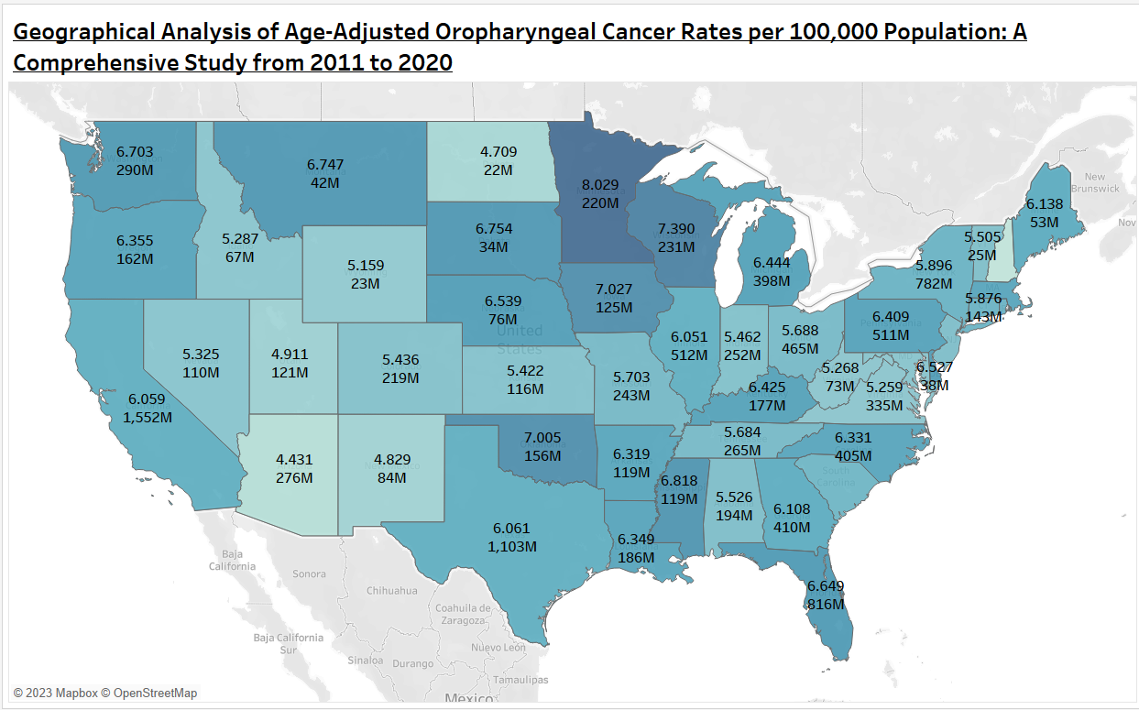
Geographical Analysis of Age-Adjusted Oropharyngeal Cancer Rates per 100,000 Population: A Comprehensive Study from 2011 to 2020

Slide 43
In this map graph, the variables are age-adjusted rate, longitude, latitude, population, and area. I used these variables from my second dataset- by area.
Age-adjusted rate – continuous variable- it is a numeric variable - it is expressed in terms of the number of cases/deaths per 100,000 people per year.
Area- discrete variable – it is a characteristic variable - string
Population- continuous variable – it is a numeric variable – it is measured in numbers
Latitude and longitude – continuous variable – it is a numeric variable – it is measured in ⁰ degrees

Slide 44
Are there significant variations in the age-adjusted rate of oropharyngeal cancer based on geographical location ???
Minnesota reports the highest age-adjusted rate at 8.029, with a population of 220 million.
Following closely, Wisconsin and Iowa report rates of 7.39 (with a population of 231 million) and 7.005 (with a population of 125 million), respectively.
In contrast, states like California, New Jersey, and Ohio exhibit comparatively lower rates.
California reports an age-adjusted rate of 6.725, impacting a sizable population of 1552 million. New Jersey follows with a rate of 5.532 and a population of 355 million, while Ohio reports a rate of 5.688, with a population of 465 million.
These variations underscore the importance of targeted interventions and region-specific strategies to address the unique challenges posed by oropharyngeal cancer in different geographical contexts.

Slide 45
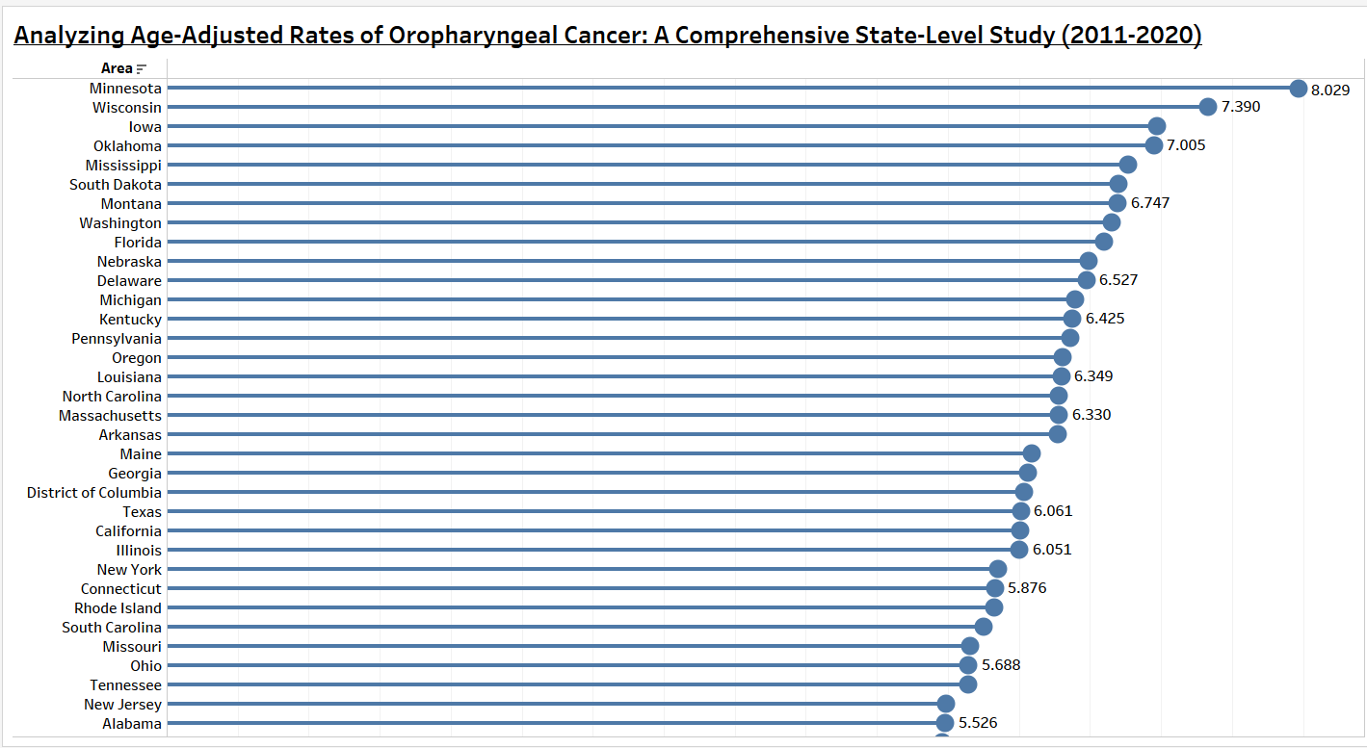

Slide 46
In this lollipop graph, the variables are age-adjusted rate and area. I used these variables from my second dataset- by area.
Age adjustment is a statistical method that can compare rates of disease, death, injury, or other health outcomes between communities with different age structures.
Age-adjusted rate – continuous – it is a numeric variable- it is expressed in terms of the number of cases/deaths per 100,000 people per year.
Area- discrete - it is a characteristic variable – string – it is expressed as names of states.

Slide 47
Geographical variations in the age-adjusted rates of oropharyngeal cancer are across states
Significant geographical variations in age-adjusted rates of oropharyngeal cancer are evident across states.
Minnesota reports the highest rate at 8.029, followed closely by Wisconsin with a rate of 7.39 and Iowa with a rate of 7.005.
In contrast, states like California, New Jersey, and Ohio exhibit comparatively lower rates, with California reporting 6.725, New Jersey at 5.532, and Ohio at 5.688.
Understanding these variations is crucial for developing effective public health initiatives and allocating resources where they are most needed.

Slide 48
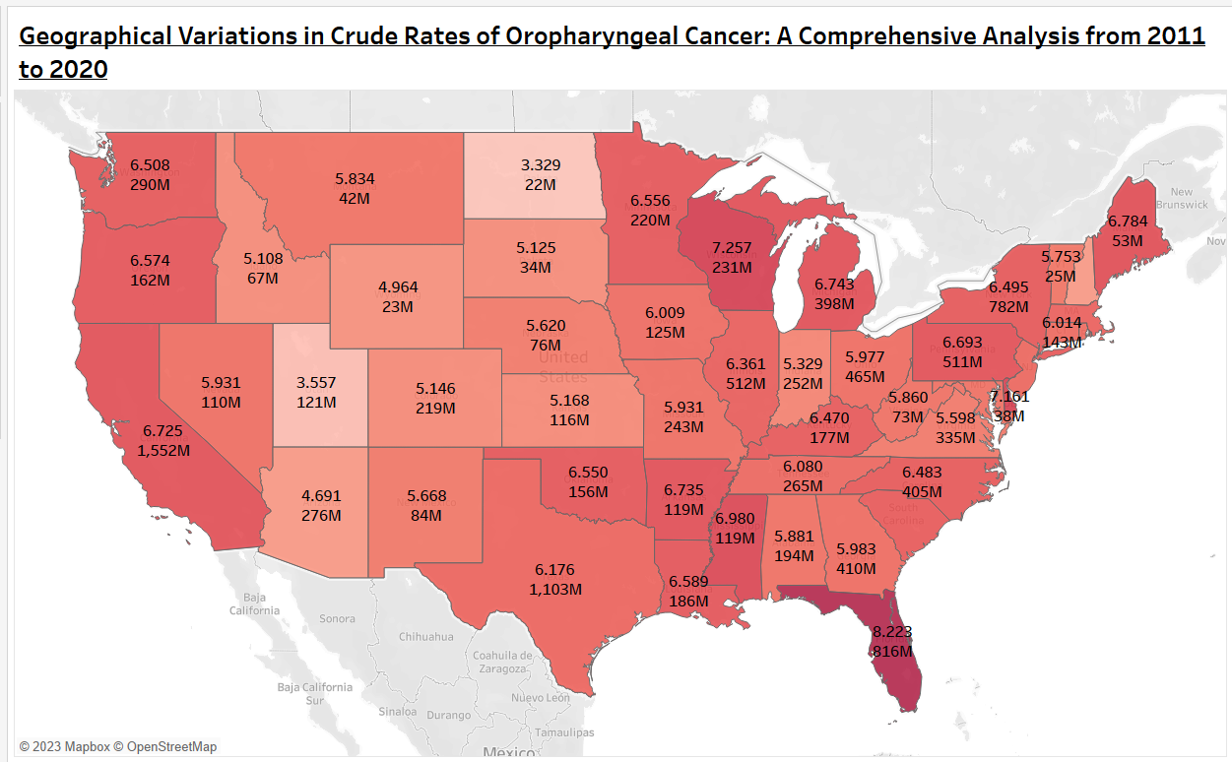

Slide 49
In this map graph, the variables are Crude rate, longitude, latitude, population, and area. I used these variables from my second dataset- by area.
Crude rate – continuous variable- it is a numeric variable – the actual rates of death/ Disease in a population
Area- discrete variable – it is a characteristic variable - string
Population- continuous variable – it is a numeric variable – it is measured in numbers
Latitude and longitude – continuous variable – it is a numeric variable – it is measured in ⁰ degrees

Slide 50
Are There Significant Variations in the Crude Rate Of Oropharyngeal Cancer Based on Geographical Location ???
Variations in the crude rates of oropharyngeal cancer across states highlight specific geographic hotspots.
Florida leads with a crude rate of 8.223, followed closely by Wisconsin at 7.257 and Delaware at 7.161. Despite differences in population sizes, these states share a concerning commonality in elevated crude rates.
Florida, with a population of 816 million, Wisconsin with 231 million, and Delaware with 38 million, underscore the urgency for targeted public health interventions in these regions.
Understanding the geographical distribution of crude rates is essential for tailoring prevention and treatment strategies to address the unique challenges faced by each state.

Slide 51
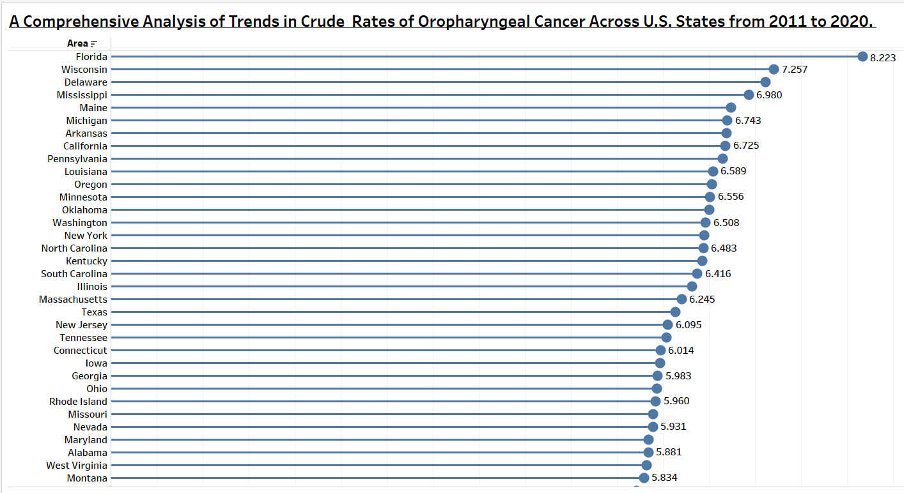

Slide 52
In this lollipop graph, the variables are Crude rate and area. I used these variables from my second dataset- by area.
A crude rate is defined as the total number of events, or count, divided by the mid-year total population of the selected geography and multiplied by a constant, which is a multiple of 10.
Crude rate – continuous – it is a numeric variable- it is expressed in terms of the number of cases/deaths per 100,000 people per year.
Area- discrete - it is a characteristic variable – string – it is expressed as names of states.

Slide 53
Geographic Disparities in Oropharyngeal Cancer Crude Rates
Analyzing the crude rates of oropharyngeal cancer across states uncovers notable geographic variations.
Florida takes the lead with the highest crude rate at 8.223, followed closely by Wisconsin at 7.257 and Delaware at 7.161.
These results underscore the importance of implementing targeted public health interventions in areas with elevated crude rates.

Slide 54
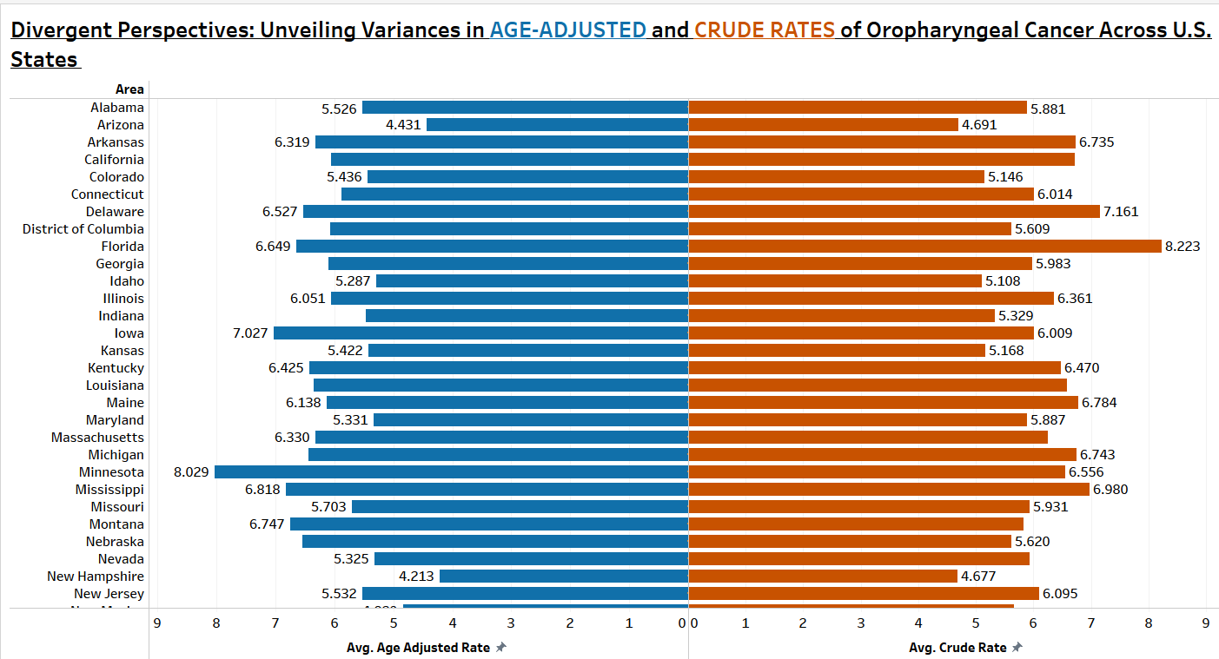

Slide 55
In this butterfly graph, the variables are age-adjusted rate, Crude rate, and area. I used these variables from my second dataset- by area.
Age-adjusted rate – continuous – it is a numeric variable- it is expressed in terms of the number of cases/deaths per 100,000 people per year.
Crude rate – continuous – it is a numeric variable- it is expressed in terms of the number of cases/deaths per 100,000 people per year.
Area- discrete - it is a characteristic variable – string – it is expressed as names of states.

Slide 56
How do age-adjusted rates of oropharyngeal cancer compare to crude rates, and do they reveal different insights into the disease's prevalence?
The discrepancy between these rates highlights the influence of age structure on disease occurrence.
While Minnesota reports the highest age-adjusted rate at 8.029, reflecting variations considering age differences, Florida, Wisconsin, and Delaware stand out with elevated crude rates, emphasizing specific geographic hotspots.
A state with a high crude rate might have a population with a higher proportion of older individuals, contributing to the elevated crude rate. The age-adjusted rate provides a standardized measure, allowing for a fairer comparison between populations with different age structures. Therefore, a state could have the highest crude rate due to population size but not necessarily the highest age-adjusted rate when considering age distribution.

Slide 57
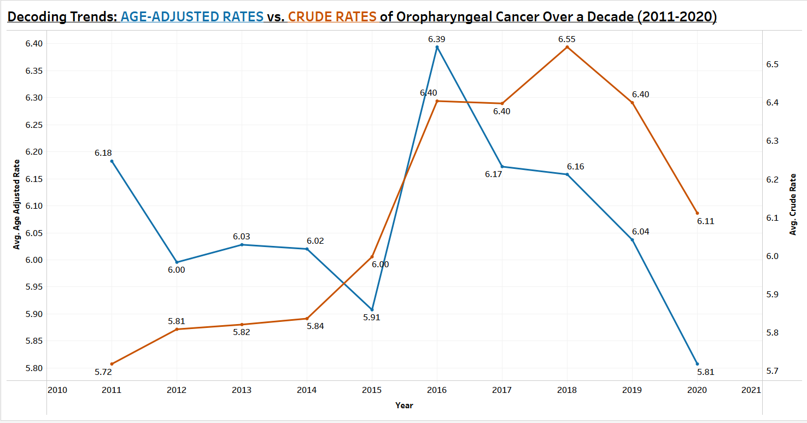

Slide 58
In this line graph, the variables are age-adjusted rate, Crude rate and year. I used these variables from my second dataset- by area.
Age-adjusted rate – continuous – it is a numeric variable- it is expressed in terms of the number of cases/deaths per 100,000 people per year.
Crude rate – continuous – it is a numeric variable- it is expressed in terms of the number of cases/deaths per 100,000 people per year.
Year – continuous variable – it is a numeric variable – it is measured in numbers

Slide 59
How do age-adjusted rates of oropharyngeal cancer compare to crude rates, and do they reveal different insights into the disease's prevalence?
When observing age-adjusted rates, there is a discernible fluctuation over the years, with a peak rate of 6.39 in 2016 and a subsequent decline to 5.8 in 2020. This suggests a dynamic trend, accounting for age variations and providing a nuanced understanding of the disease's impact.
In contrast, crude rates show a different trajectory, with a gradual rise from 2011 to 2014, a sudden increase in 2016, and a notable peak in 2018.
The rates exhibit a subsequent decline in 2019 and 2020. This trend indicates variations in raw incidence without adjusting for age differences.
Overall, the comparison highlights the importance of considering age-adjusted rates for a comprehensive understanding of oropharyngeal cancer trends, as they provide a more accurate reflection of the actual prevalence, mitigating the influence of age-related factors on the observed patterns.

Slide 60
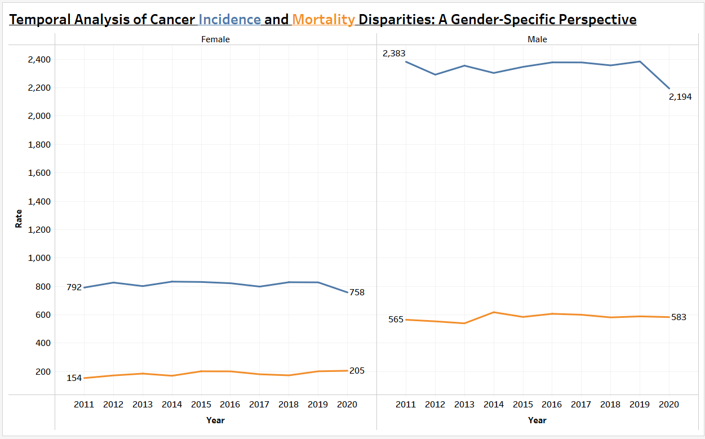

Slide 61
In this line graph, the variables are sex, event type, and rate. I used these variables from my first dataset- By Age.
Gender – discrete variable – it is a characteristic variable - string
Event type – discrete - it is a characteristic variable - string
Rate – continuous – it is a numeric variable – it is measured in numbers

Slide 62
Does the incidence and mortality of oropharyngeal cancer differ significantly between genders, and are there any observable trends or disparities?
The analysis of oropharyngeal cancer incidence and mortality across genders reveals notable disparities.
From 2011 to 2020, the incidence rates showed a decrease for both females (from 792 to 758) and males (from 2,383 to 2,194). Conversely, mortality rates exhibited an increase for females (from 154 to 205) and a relatively stable pattern for males (from 565 to 583).
These trends suggest a gender-specific divergence, with a declining trend in incidence rates for both genders but an upward trajectory in mortality rates for females. The observed patterns emphasize the importance of gender-specific considerations in understanding and addressing the nuances of oropharyngeal cancer outcomes.

Slide 63

SUMMARY

Slide 64
The extensive analysis of oropharyngeal cancer trends spanning a decade, encompassing age, gender, race, and geography, unveils nuanced insights into this complex health issue. Key findings include:
1. Age-Related Patterns:
- Susceptibility increases with age, notably in individuals beyond 65.
- Targeted screening for the elderly, especially those above 65, is crucial for early detection.
2. Racial Disparities:
- Non-Hispanic individuals, particularly whites, bear the highest burden.
- Tailored healthcare policies are essential to address disparities within each non-Hispanic
racial subgroup.

Slide 65
3. Geographical Variations:
- Significant divergences in age-adjusted rates across states highlight pronounced variations
in oropharyngeal cancer prevalence.
- Florida, Wisconsin, and Delaware emerge as focal points with elevated crude rates,
necessitating targeted interventions to address the unique challenges posed by oropharyngeal
cancer in diverse geographical contexts.
4. Comparison of Rates:
- Disparities between age-adjusted and crude rates highlight the influence of age-related
factors.
- States like Minnesota exhibit notable age-adjusted rates, while Florida stands out with
elevated crude rates.

Slide 66
5. Gender-Specific Trends:
- Declining incidence rates for both genders, contrasting patterns in mortality.
- Males have a higher incidence rate than Females
- Gender-specific considerations are crucial for understanding and addressing nuances
in oropharyngeal cancer outcomes.

Slide 67
limitations
Due to its retrospective nature, relying on historical records, there is a potential for reporting biases and inconsistencies.
Data collection variations among states may impact the accuracy of prevalence and incidence rates.
The study's focus on U.S. states limits its generalizability to global or diverse regional patterns.
The datasets primarily capture diagnosed cases, potentially missing undiagnosed instances, especially in areas with limited healthcare access.
The lack of detailed information on risk factors, such as tobacco and alcohol consumption, HPV infection status, and socioeconomic factors, hinders a more nuanced analysis.

Slide 68

CONCLUSION

Slide 69
This thorough investigation highlights the importance of customized public health interventions, with a focus on strategies tailored to specific regions and demographics.
Critical initiatives include early detection programs, targeted screenings for vulnerable age groups, and awareness campaigns that target high-risk racial subgroups.
The study's results provide valuable evidence for informed policy-making, guiding the allocation of resources and promoting a comprehensive approach to managing oropharyngeal cancer.
The data's dynamic trends, as seen in both age-adjusted and crude rates, emphasize the significance of considering age-related factors when assessing prevalence accurately.
Ultimately, this research lays the groundwork for ongoing efforts to enhance our comprehension of oropharyngeal cancer and improve patient outcomes.

Slide 70

REFERENCES

Slide 71
World Health Organization. (2022, February 3). Cancer. World Health Organization.
https://www.who.int/news-room/fact-sheets/detail/cancer
National Institutes of Health (US); Biological Sciences Curriculum Study. NIH Curriculum Supplement Series [Internet].
Bethesda (MD): National Institutes of Health (US); 2007. Understanding Cancer. Available from:
https://www.ncbi.nlm.nih.gov/books/NBK20362/
Sethi, S., O'Neil, M., Jensen, E., Smart, G., & Poirier, B. (2023). Toxicity with proton therapy for oral and/or oropharyngeal
cancers: A scoping review. Journal of Oral Pathology & Medicine.
Ellington, T. D., Henley, S. J., Senkomago, V., O’Neil, M. E., Wilson, R. J.,Singh, S., … & Richardson, L. C. (2020). Trends in
incidence of cancers of the oral cavity and pharynx—United States 2007–2016. Morbidity and Mortality Weekly
Report, 69(15), 433.

Slide 72
Ferlay, J., Colombet, M., Soerjomataram, I., Mathers, C., Parkin, D. M., Piñeros, M., ... & Bray, F. (2019). Estimating the global
cancer incidence and mortality in 2018: GLOBOCAN sources and methods. International journal of cancer, 144(8),
1941-1953.
Tofthagen C. (2012). Threats to validity in retrospective studies. Journal of the advanced practitioner in oncology, 3(3), 181–183.
US Cancer Statistics Working Group. (2017). United States cancer statistics: 1999–2014 incidence and mortality web-based
report. Atlanta: US Department of Health and Human Services, Centers for Disease Control and Prevention and
National Cancer Institute, 201.
Centers for Disease Control and Prevention. (2023, June 13). United States Cancer Statistics. Centers for Disease Control and
Prevention. https://www.cdc.gov/cancer/uscs/

Slide 73


